Slide 1
Military Medical Records Composition
Gail Hamilton and Jeff C. Hoyt
703-983-7855 • ghamilton@mitre.org
703-983-6241 • jchoyt@mitre.org
MITRE Internal Information
For Limited External Release

Slide 2
Overview
We want to demonstrate ways to give
caregivers more time to do what matters most
Showcase CCoD¹ principles to provide relevant data quickly
Provide components to streamline their current workflow
¹Composable Capability on Demand
Notes:
We wish to provide a means to demonstrate to the clinicians a way to access to the most relevant data when they need it.
This will help the caregivers to spend more time providing effective care.
We plan to do this through using CCoD principles to provide relevant and timely information to the clinician.
And provide a small number of compelling components,to be used within this framework to help streamline the physicians current workflow.

Slide 3




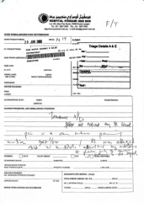
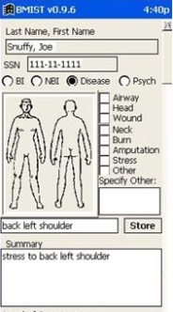


The Current Workflow
Phone
Email
Fax
Vista
AHLTA
Outside Records
Has 15 minutes per patient
Notes:
They have, on average only 15 minutes to spend with each patient.
And have even less face time with a patient.
In this time they must
access the situation ,
to diagnose problem and
verify that old and new data confirms/ refutes this hypothesis
recommend treatment
To do this the doctor has to sift through a large amount of information, from various sources some of it not readily available.
These sources of information include:
VISTA – The system that they will currently be using to store patient records, or using as a messaging system
Email – generally Outlook
Fax – for any information that has been faxed from other clinicians or from outside sources
Phone – After a phone call, the physician has to write down the salient points of the call
And any scanned in records that are generically labeled “outside records”, and ,may include records from
AHLTA – The DoD medical system.
As a physician put it: “Everyday you need to search all these sources of information for data.”
Which leads to this…
All this information must be searched through and correlated in the physician’s head.
Which leads to this…

Slide 4
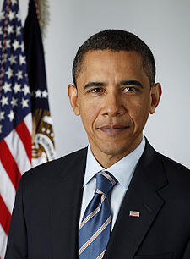
Joint Defense/VA Lifetime EHR Project
“Currently, there is no comprehensive system in place that allows for a streamlined transition of health records between DOD and the VA” *
“creating one unified lifetime electronic health record for members of our armed services that will contain their administrative and medical information -- from the day they first enlist to the day that they are laid to rest.” [President Obama April 9, 2009]*
*http://www.whitehouse.gov/the_press_office/
Remarks-by-the-President-on-Improving-Veterans-Health-Care-4/9/2009/.
Notes:
And with new administration’s priority to provide comprehensive healthcare
for Veterans through an
electronic lifetime health record
the amount of information will quickly become overwhelming.

Slide 5
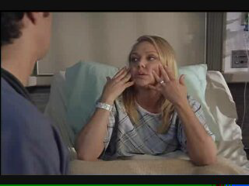
15 seconds
Click to play movie
Notes:
This film demonstrates the problem that most physicians face. Lack of time to do the most important activities.

Slide 6
How do we do it?
Providing a way for physicians to process the non categorized “Outside records”
Providing an extensible User Defined Interface for clinicians to allow them to be more efficient
Work closely with SMEs
Christian Donahue, M.D. (Durham Medical Center, NC)
National Primary Care Redesign Workgroup
Durham VA Systems Redesign Steering Committee
Durham VA Primary Care Redesign Committee
Notes:
So how do we attempt to solve this problem?
By tackling the problems by applying Composable capabilty on demand principles to the Healthcare domain.
The first part is to provide a way for physicians to deal with the cumbersome and time consuming “Outside records”.
The second is to provide a flexible, easily extensible User defined interface.

Slide 7
How do we do it?
Providing a way for physicians to process the non categorized “Outside records”
Deal with “outside records” (CITL Category 2 data)
Category 2 data is defined as images with little or no metadata
Categorize according to physician’s workflow
Providing an extensible User Defined Interface for clinicians to allow them to be more efficient
Create composable record view
Define “loose couplers” for medical data and category 2 data
Templates
Notes:
Our first goal is to allow for processing of image data.
Center for Information Technology Leadership (CITL) has defined 4 levels of data interoperability, for the DOD/VA Information Interoperability Plan.
Our target is to help deal with the Category 2 and 3 Data.
Category 2 data is defined as image data that with little or no meta data associated with it.
Category 3 is machine readable data, such as PDF’s.
We will explore ways to categorize and index these category 2 records in a way that is useful to clinicians

Slide 8


Deal with “outside records”
Fax
Email
Phone
Vista
Outside Records
AHLTA
Notes:
Having the capability to deal with the CITL Category 2 and 3 data is key for physicians.
And means that we will be able to help physicians with the problem of accessing outside records.
These outside records include images from AHLTA.
Right now to bring up one image, an outside record, is a time consuming task.
If a physician wants to see an XRAY film, he has to wait 2 minutes to bring up list of images,
click from the list, and wait 30-40 seconds for that image to load.
And the physician may have to view hundreds of records to get to the one he wants.
In addition these are uncategorized and labelled generically as Outside records.
Which means that the physician is unable to filter on these records.

Slide 9



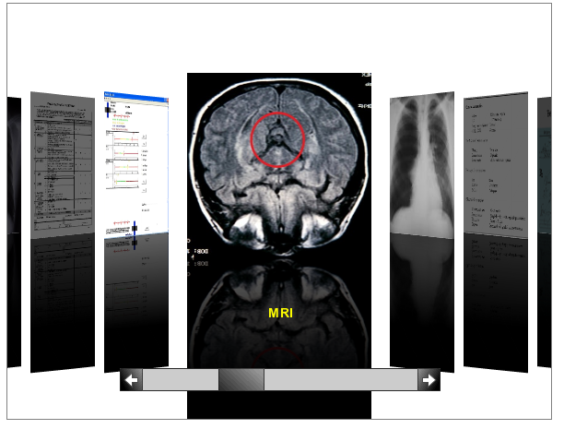
Deal with “outside records”
Pre-filter by date and category
Parse PDF files and apply text mining techniques
Simulate “flipping the chart”
Generate thumbnails that can be flipped through with a coverflow-like interface
“LOVE IT” [Christian Donahue, M.D., VA Physician, Raleigh, N.C.]
Allows more rapid access of files, spending time only on those that appear useful
Notes:
To overcome this :
We wish to allow for categorization of the image/pdf ‘outside record’ files .
To do this, we intend to allow for categorizing of the image data.
For example by SOAP (Subjective, Objective, Assessment, and Plan) attributes, or date.
Leveraging MITRE research work and expertise. (ARGUS)
We have already identified Open Source OCR tools that will facilitate this.
tesseract-ocr http://code.google.com/p/tesseract-ocr/
GOCR http://jocr.sourceforge.net/
Once the images are categorized, even very roughly,
The physician will then be able to quickly filter the data according to this category
and so allow the physician to prioritize and then access the most relevant data.
To access the image data quickly
We will build a component to allow for the Physician to electronically ‘flip’ through image data using a Coverflow interface.
As you can see. This is a very simple easy to use interface, similar to what is used to view photographs and images on iPhones.
Typically the physician knows what he is looking for. And whilst would find it hard to identify through a search criteria – he will know it when he sees it.
This will help overcome the cumbersome and time consuming workflow that the physician has to go through currently, to access outside records.
Talking with multiple SMEs this in particular has received enthusiastic response And credit must go to Jean Stanford on this , as it was originally her idea.

Slide 10
How do we do it?
Providing a way for physicians to process the non categorized “Outside records”
Deal with CITL Category 2 data
Category 2 data is defined as images with little or no metadata
Categorize according to physician’s workflow
Providing an extensible User Defined Interface for clinicians
Using CCoD principles
Create composable record view
Define “loose couplers” for medical data and category 2 data
hData
Templates
Notes:
The second goal is to provide an User Defined Interfaced for the physician.
Allowing the physician to create his own composable record view of a patient.
This will involve using a ‘loose coupler’.
A loose coupler is a data standard, usually widely accepted around which systems or components can interact.
The ‘loose coupler’ generally encapsulate a domain’s most important common data set.
For the medical domain, there is current efforts underway at MITRE to define this core data set.
This effort, called hData, will result in a XML schema for the core medical data.
In addition we will leverage the idea of using Templates which I will describe in more detail later.

Slide 11
Composable Interface
Fax
Email
Phone
Vista
Outside Records
AHLTA
Notes:
This composable interface will bring together all the information sources into one seamless interface.
Including the VISTA records, the email records and provide a means to enter in the phone data in one place.

Slide 12
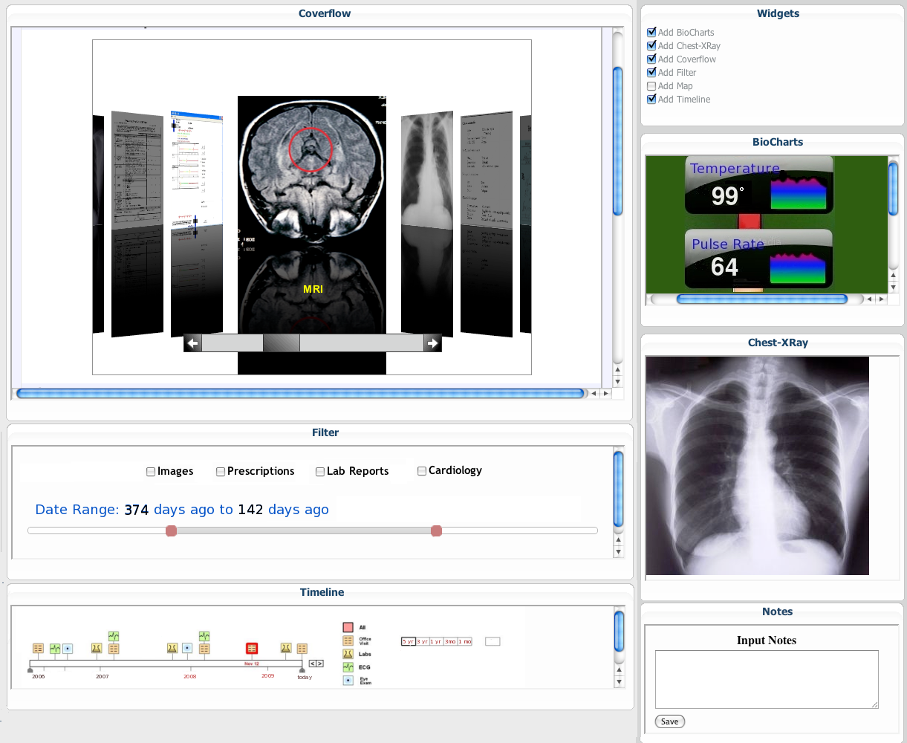
Composable Interface Mockup
Notes:
Here we see an example of the expected interface.
This is very simple mock up of the type of interface we would be looking to build.
If we have time I can demo this at the end of the presentation.
It is a simple example, built using iGoogle as a framework. Similar to the MII ‘portal’ interface.
New components can be added as they become available. Using a simple check box.
All components will communicate with one another via the loose coupler. Currently identified as hData.
The filter bar allows for filtering the thumbnail images , easily on a window of time.
Or on predefined categories .
If the physician clicks on an image, it will download this image and add it automatically to the interface.
Where it can be saved as part of the view or later discarded.
As you can see these images can be added and viewed easily.
The interface allows for extensibility, as new components are built ,
they can be easily integrated into the system.
Here we have examples
Such as the BioChart component, showing a quick glance of patients temperature or heart rate over time.
Clicking on this would bring up a more detailed chart.
Other components identifed as useful by SME’s
such as a visual timeline of patent history, showing a summary of such events as
Office visits
Lab results.
Eye exams
Routine checkups

Slide 13
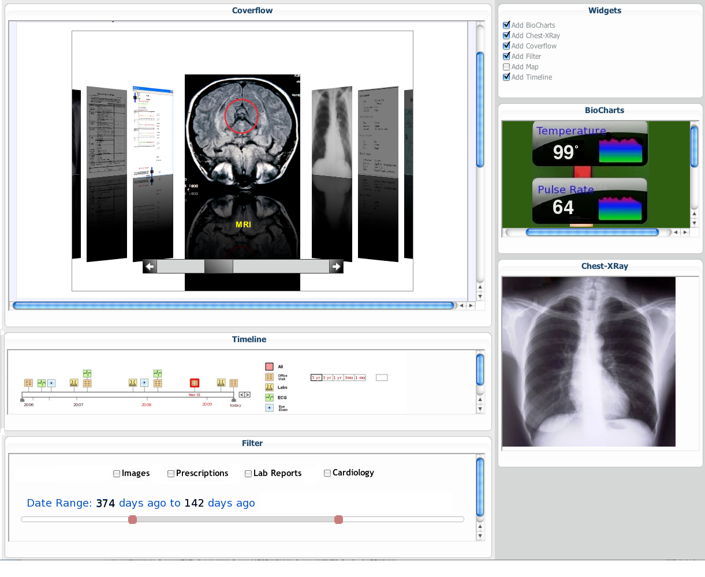
Composable record view (1 of 2)
UDOP for healthcare
Create a User-Defined Operational Picture for health record
Allows for a “dashboard” like interface where all the important information is readily accessible
Unfortunately many software companies prefer a “one size fits all” approach
to development and end up creating a “one size fits nobody” product”
Jim Bradford, Ph.D. The Bradford Report
Notes:
One of the problems identified by current efforts, is that the traditional “one size fits all” system, results in a “one size fits none solution”.
This is probably primarily due the disparate users and variety of needs of different clinicians ad specialities.
The UDOP interface provides the user with the flexibility to define his own interface.
Allowing him to add and discard components as required.
Each component, provides a summary of data, and allows for drilling down to get more detail.

Slide 14
Composable record view (2 of 2)
Customized for caregiver/patient pair
“MyInterface”
Reduces time needed to re-acquire SA
Snapshot
Templates
Reduces time to set up view
Notes:
The physician needs to be able to rapidly access only the most pertinent data for a particular patient.
We provide this by allowing for the clinicians to customize the view on a per-patient basis
And save a View for each patient.
If a person comes in with a broken leg, then the clinician should pull up a view for ‘leg
injuries’, for example.
That will show information commonly required in this case.
E.g. An XRAY, notes from interview with patient about incident, allergies etc,..
They can then Save the View. Which will reduce dramatically the time required to re acquire information about a patient.
As a Dr Donohue put it, like ‘picking up where you left off with an old friend’.
If another person wishes to review the same patient they can create their own view.
In addition, as many of the data sources are from ‘outside systems’.
There is a need to allow for the physician to create a snapshot of all the data
at a particular point in time, e.g. at time of a diagnosis and prescribing of treatment.
In addition, the ‘Views’ or ‘Templates’ that others have created will be viewable, based on access rights, to other clinicians.
A clinician can also add any components that may be additionally useful.
E.g. Viewer of Endocrinology test results, to see if patient has history of thyroid problems, that may indicate osteoporosis.
As new components are developed they can be easily integrated into the current system.
New components, or widgets will be necessary, and we will work on identify the most useful set, from SME’s input.

Slide 15
Key Deliverable: FY10 Prototype
User Defined Interface
Categorize images outside records
MyInterface
Customizable to clinician’s requirements
Templates
Components
Coverflow interface to review images
Filter criteria
‘See’ what other components were used to review patient’s history
Add new SME identified components (e.g. Timeline)
Notes:
Here is the set of

Slide 16
Possible Follow-ons
Speech to Text
Transcribe doctors dictation notes
Alerts
Alert other clinicians through system, rather than email
Email, paper to patient automatically through system
Automatically call patient, leave text message
Note plugin
allow for cutting and pasting from other components

Slide 17
Why we can succeed
PIs
Experience with CCoD
Experience with medical data
Proven history of building production systems and prototypes
Leveraging hands-on SMEs
Christian Donahue, M.D.
Tom Neal, M.D. (MITRE, experience with DoD medical system)
Joy Keeler, Jean Stanford (MITRE, data issues)
Notes:
I have been working with CCoD through various PDI efforts in C2C.
And have become familiar with what processes need to be acarried out to create a CCoD system.
Jeff and I have had extensive experience, through various NIH projects on working with medical data, primarily image data such as MRI. As well as successfully creating systems to aid medical research. One, neuroMorpho.org at GMU has become the standard system for storing and viewing neuron data.
SME’s are excited about our ideas.

Slide 18
MIP Collaborations
LAIKA (Andy Gregorowicz, existing work)
Provide data, hData
Multimodal Medical Data Capture and Representation (Qian Hu, existing MSR)
Speech to text capability
Automating Fact Extraction from Medical Records, (Cheryl Clark, proposed MSR)
Medical fact extraction to enhance “outside record” categorization
Notes:
In providing a composable framework. We will also be able to leverage and help other proposed and ongoing MIP efforts. By being able to collate these research systems and prototypes into one system.
We have already discussed potential collaborations with the research proposals listed here.
This will provide functionality that is greater than the sum of the parts.

Slide 19
Risks & Mitigation Strategies
Risk: Medical data is too complex to derive a true “loose coupler”
Mitigation:
hData effort (MITRE)
Can use 2 or more loose couplers if necessary
Risk: hData effort has funding cut
Mitigation: Start where they stopped and use MIP funds to get minimal functional format
Risk: Lack of data
Mitigation: Create realistic simulated data with Laika

Slide 20
Project Timeline
Total cost/duration: 1 yr/$325,000

Slide 21
Transition Strategy
We have excellent connections with sponsors that can influence adoption of these methods
Work closely with Christian Donahue, M.D., Veterans Administration, who helped shape this proposal
He is on the VA working group that is planning the future of VA healthcare management and information systems
Brief Vice Chief of Staff, Washington VA Medical Center
Colleague of Tom Neal, M.D. (V600)
Public release as an open source project
Jim Inskeep will identify additional VA sponsors
Finally, any new, specialized loose couplers and widgets generated will be transitioned to other CCoD efforts
Notes:
JCH -> All components of our system will be publicly released and as an open source project (Apache 2.0 license, most likely) to encourage vendors to evaluate and adopt our work. The Apache 2.0 open source license is very business friendly, which is important to ensuring the work reaches the widest audience possible in this domain.
Any new components will be written to be as domain independent as possible, to allow for transition to other CCoD efforts within MITRE.

Slide 22
Impact If Successful
Demonstrate ways to give
caregivers more time to do what matters most.

Slide 23
C3H Strategic Roadmap
Help VA Physicians to be more efficient, by allowing them to be able to compose interface to meet individual needs

Slide 24
Thank you!

Slide 25
Composable Interface Demo

Slide 26
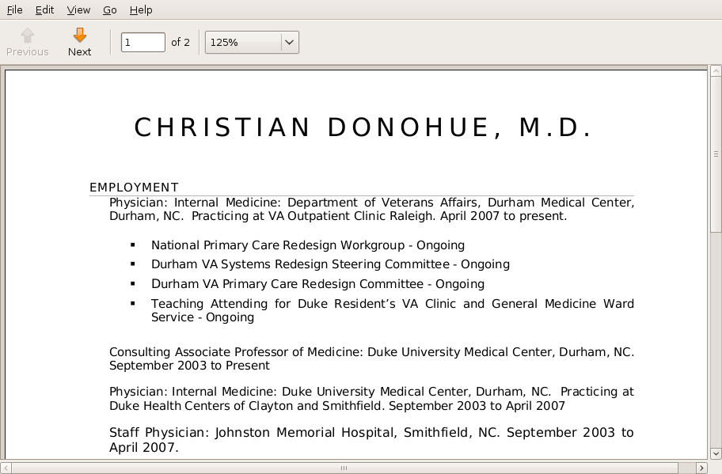

Slide 27
What to do?
We will explore the benefits of applying the concepts of CCoD to VA healthcare professionals
Provide User Defined Operating Picture (UDOP) for physicians
Utilize “loose couplers” and new GUI approaches to more quickly process historical data
Address current problem areas where this approach will help most
If widely accepted, this would
Allow physicians to assess the situation (achieve SA) faster
Provide more time to acquire new information (talk to patient) and analyze the situation
Notes:
We will explore, using the concepts of composable capabilty on demand (referred to as CCoD) as a way to provide an
interface that will help VA professionals get the information they need when they need it.
We do this by providing a User Defined Operating Picture, or UDOP for the physicians.
UDOP is a graphical user interface that allows the user more control to see only the most relevant information.
A simple example is Dashboard interface. Allowing the user to add and drop widgets as desired and build their own interface to view the data.
It also allows for complimentary views of the same data by use of a common data format, called a ‘loose coupler’.
A loose coupler is a widely accepted data standard which I will describe in more detail later.
Using this UDOP interface with a the loose coupler we will be able to provide the physicians a means to quickly asses a situation.
And allow the physician to more efficiently use his time to acquire information by talking with the patient and more thoroughly analyzing the situation.
We will also look to subject matter experts to provide components to address areas which currently are time consuming and/or unworkable.
.

Slide 28
Deal with CITL Category 2 data
Pre-filter by date and category
Parse PDF files and apply text mining techniques
Simulate “flipping the chart”
Attempt to identify useful parts of the file and generate thumbnails that can be flipped through with a coverflow-like interface
“LOVE IT” [Christian Donahue, M.D., VA Physician, Raleigh, N.C.]
Allows more rapid access of files, spending time only on those that appear useful
Notes:
To support this processing, a physician need rapid access to the pertinent and useful data, while being able to ignore the rest.
To do this, we intend to allow for categorizing of the image data. For example by SOAP (Subjective, Objective, Assessment, and Plan) attributes, or date.
The physician will then be able to quickly filter the data according to this category and so allow the physician to prioritize and then access the most relevant data.
Also suggested by a SME
Another suggestion from a SME is to have an set of tabs for ‘notes’ ‘labs’ ‘reports’ ‘consults’ ,‘demographics’ ‘outside’.
We will build a component to allow for the Physician to electronically ‘flip’ through image data using a Coverflow interface, which I will describe on the next slide.
Talking with multiple SMEs this in particular has received enthusiastic response And credit must go to Jean Stanford on this , as it was originally her idea.
This will allow the Physician to spend more time on more useful activities and less time searching through stacks of information.
CITL is Center for Information Technology Leadership

Slide 29
Define “loose couplers”
Loose coupler is
an accepted data standard around which systems or components can interact
captures a domain’s most important common data set.
CCoD loose couplers are
COT, UCORE, KML
Medical data
hData is a likely target
http://mitrepedia.mitre.org/index.php/HData
Category 2 data
Create limited number of adapters
Create adapters from current medical standards to hData
Notes:
Loose couplers
A loose coupler is an accepted data standard, usually widely accepted around which systems or components can interact.
They generally encapsulate a domain’s most important common data set.
A simple example, used for geographic information is KML, an XML standard used to define geographic information very simply .
KML allows for disparate geographic information sources to be easily combined through this common format, into a single interface, most commonly Google Earth.
In our case the most likely candidate for a loose coupler for medical data is hData. This is a MITRE driven effort, to define an XML schema to better represent and access the continuity of care data. This effort looks to identify a subset of data from C32 .
We will work to create loose couplers between C32 data standard, and hData. And identify and create other adaptors

Slide 30
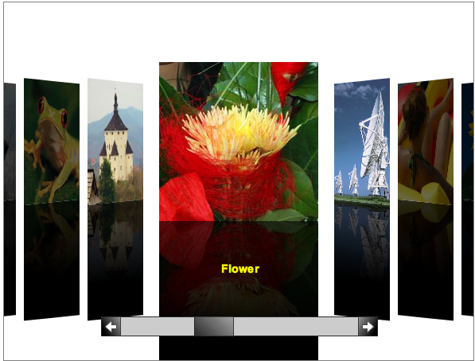
Coverflow Demo
Allow for viewing of image data.
Notes:
As you can see. This is a very simple easy to use interface, similar to what is used to view photographs and images on iPhones.
This will allow the physician to ‘flip’ through any data that they may have in electronic format, the category 2 information.
Typically the physician knows what he is looking for. And whilst would find it hard to identify through a search criteria – he will know it when he sees it.
At the moment to bring up one image takes around 30 – 40 seconds. Essentially making viewing of images a inefficient use of the physicians time. And requires far more than the allotted 15 minutes per patient.

